Slide 1
Mathematical Models for Facility Location
Prof Arun Kanda
Department of Mech Engg
Indian Institute of Technology, Delhi

Slide 2
A Case Study
A Decision Model for a Multiple Objective
Plant Location Problem
Prem Vrat And Arun Kanda
INTEGRATED MANAGEMENT, July 1976, Page 27-33

Slide 3
Objective of Location
To set up a straw board plant (Packaging material) from industrial waste
Plant
Sources of
Industrial waste
Industries needing
packaging material

Slide 4
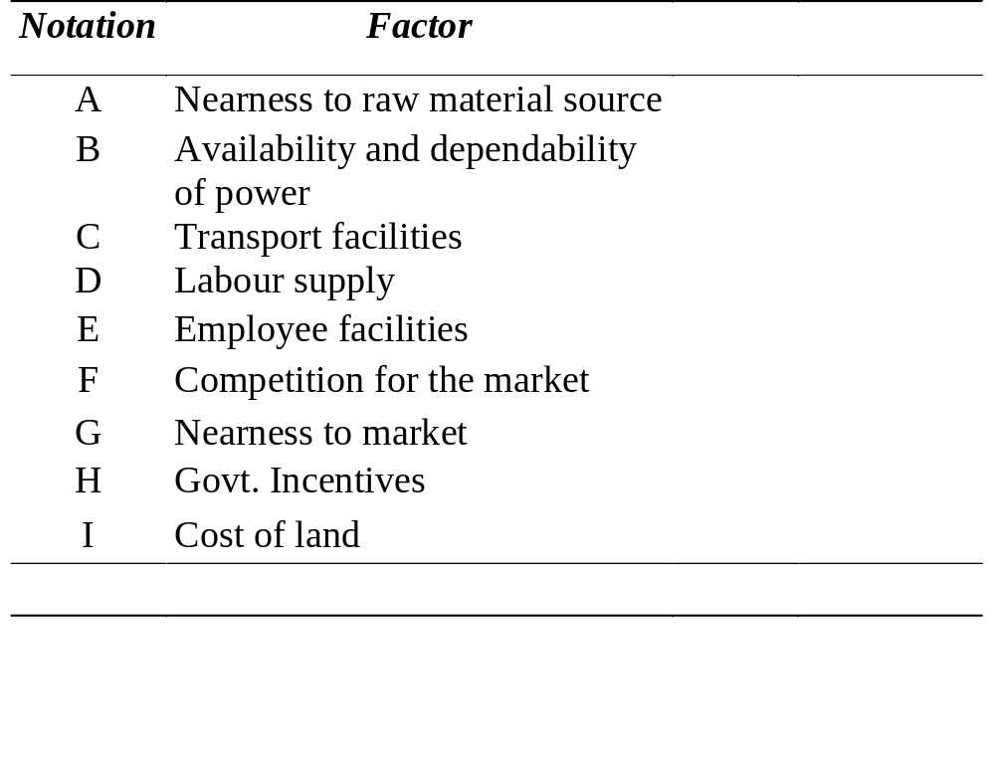
Relevant Factors for Plant Location

Slide 5
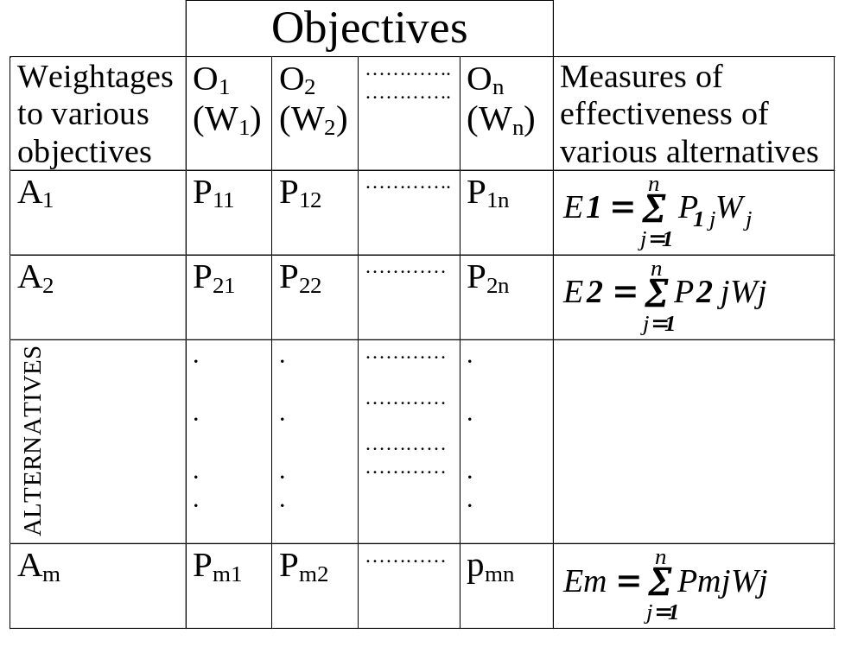

Slide 6
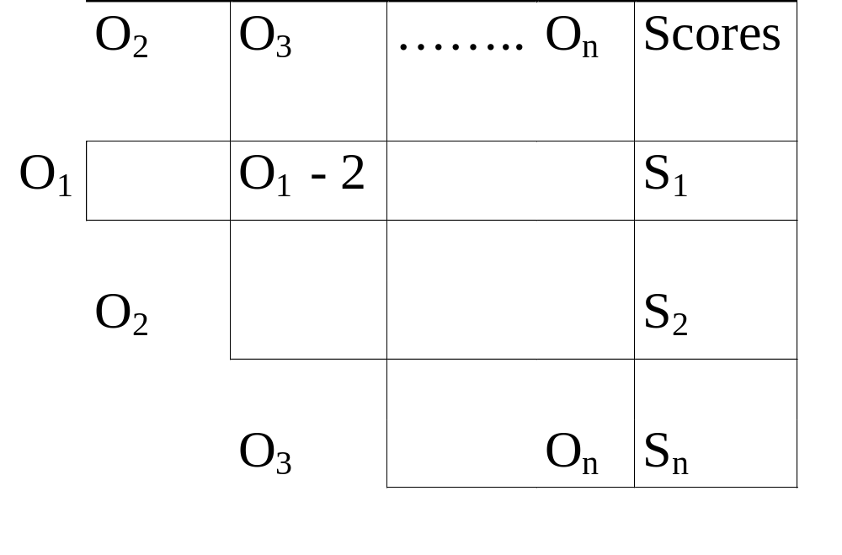
Triangular Matrix

Slide 7
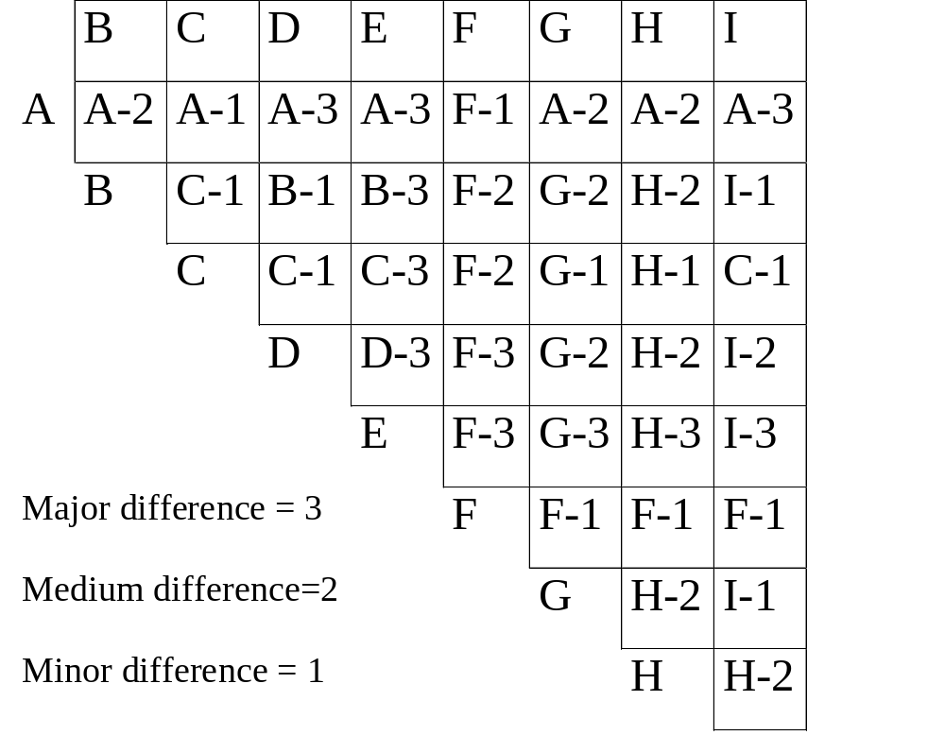
Applying Pareto Principle

Slide 8
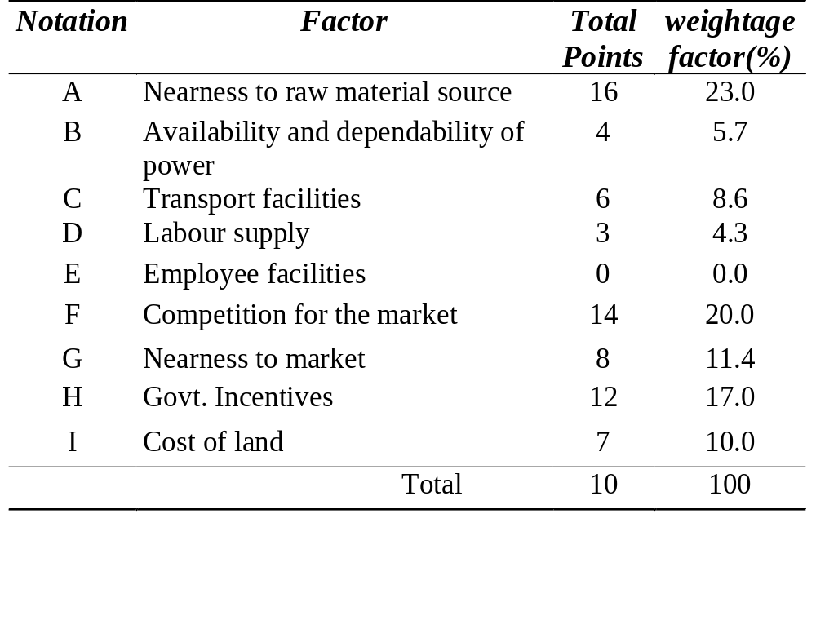
SUMMARY

Slide 9
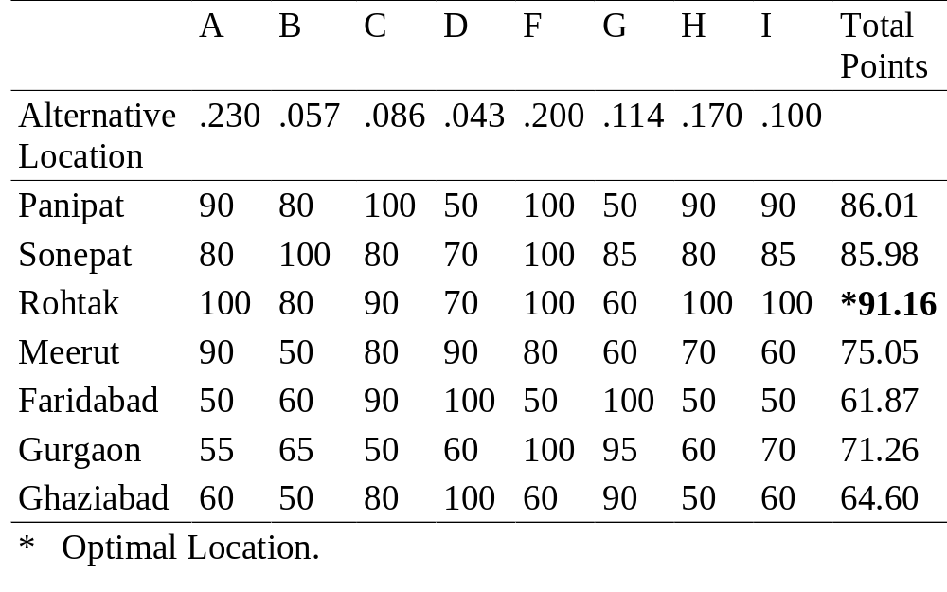
Decision Matrix for Alternative Locations

Slide 10
Normalization I
80
P
Points
20
L
C
H
Capital Cost

Slide 11
Normalization II
D
A
80
C₁
Points
C₂
20
B
L
L’
H
Capital Cost

Slide 12
Normalization III
80
60
Points
20
| Restive | Satisfactory Cooperative |
Labour Attitudes

Slide 13
Normalization IV
O_{n}
.
.
.
Points
O₂
O₁
X₁
X₂ - - - - - -
X_{n}

Slide 14
Mathematical Models for Facility Location

Slide 15
Single Facility Location
New lathe in a job shop
Tool crib in a factory
New warehouse
Hospital, fire station, police station
New classroom building on a college campus
New airfield for a number of bases
Component in an electrical network
New appliance in a kitchen
Copying machine in a library
New component on a control panel

Slide 16
Problem Statement
m existing facilities at locations
P₁(a₁,b₁), P₂(a₂,b₂) … P_{m}(a_{m},b_{m})
New facility is to be located at point X (x,y)
d(X,P_{i}) = appropriately defined distance between X and P_{i}
  Euclidean, Rectilinear, Squared Euclidean
  Generalized distance, Network
The objective is to determine the location X so as to minimize transportation related costs
Sum (i=1,n) w_{i} d(X,P_{i}), where w_{i} is the weight associated with the ith existing facility (product of Cost/distance & the expected number of annual trips between X and P_{i})

Slide 17
Single Facility Location
P₃ (w₃)
P_{n-1} (w_{n-1})
d(X,P₃)
P₂ (w₂)
d(X,P₂)
d(X,P _{n-1})
X
d(X,P_{n})
d(X,P₁)
P₁ (w₁)
P_{n} (w_{n})

Slide 18
Commonly Used Distances
Pi (ai,bi)
Rectilinear: | (x-ai) | +| (y-bi)|
Euclidean : [ (x-ai)² + (y-bi)²]^{1/2}
Squared
Euclidean: [(x-ai)² +(y-ai)² ]
Other , Network
X (x,y)
Pi (ai,bi)
X (x,y)
Pi(ai,bi)
X (x,y)

Slide 19
Rectilinear Distances
Z = Total cost
= Sum (i =1,n) [ wi | (x-ai) + (y-bi)|]
= Sum (i=1,n) [wi |(x-ai)| + wi |(y-bi)| ]
= Sum (i=1,n) wi |(x-ai)| +
Sum (i=1,n) wi |(y-bi)|
= f₁(x) + f₂(y)
Thus to minimize Z we need to minimize f₁(x) and f₂(y) independently.

Slide 20
Example 1
(Rectilinear Distance Case)
A service facility to serve five offices located at (0,0), (3,16),(18,2) (8,18) and (20,2) is to be set up. The number of cars transported per day between the new service facility and the offices equal 5, 22, 41, 60 and 34 respectively.
What location for the service facility will minimize the distance cars are transported per day?

Slide 21
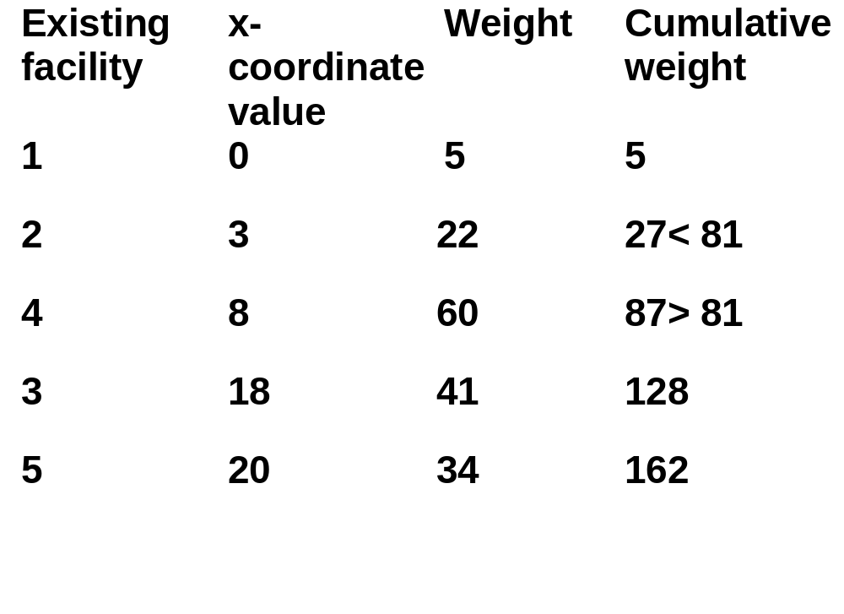
Solution (x-coordinate)
x* = 8

Slide 22
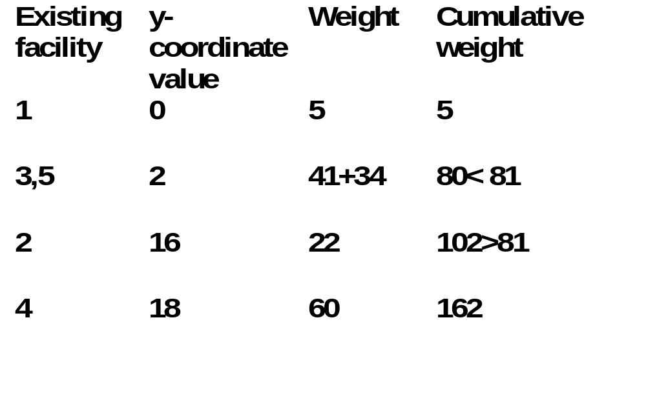
Solution (y-coordinate)
y* = 16

Slide 23
Example 2
Squared Euclidean Case
CENTROID LOCATION
x* = Σ wi ai /Σ wi =( 0 x5 + 3x22 + 18x41 + 8x60 + 20x34)/162
= 12.12
y* = Σ wibi/Σ wi = (0x5 + 16x22 + 2x41 + 18x60 + 2x34)/162
= 9.77
(Compare with the median location of (8,16)

Slide 24
R_{m}
R₂
ω_{m}
P
M_{n}
R₁
ω_{m+n}
ω₂
M₂
M₁
ω₁
ω_{m+2}
ω_{m+1}

Slide 25
Minimax Problems
For the location of
emergency facilities
our objective would
be to minimize the
maximum distance
*

Slide 26
Cost Contours
Increasing Cost
Cost Contours
help identify alternative
feasible locations

Slide 27
Summary
Decision Matrix approach to handle multiple objectives in Plant Location
(problem of choosing the best from options)
Single Facility Location Models
  Rectilinear distance
  Squared Euclidean
  Euclidean distance
  (to generate the best from infinite options)

Slide 28
Summary (Contd)
Notion of Minisum and Minimax problem
(Objective depending on the context)
Use of Cost Contours to accommodate practical constraints
(Moving from ideal to a feasible solution)

